Slide 1


Hurt and Grievous Hurt
Presented by,
Name: Manoranjan Sarkar
St. Code : BWU/BTA/24/037
Course Code : LLB105
Course Name : Law of Crimes 1
Program Name: LLB
Section : A , Sem : 1st

Slide 2

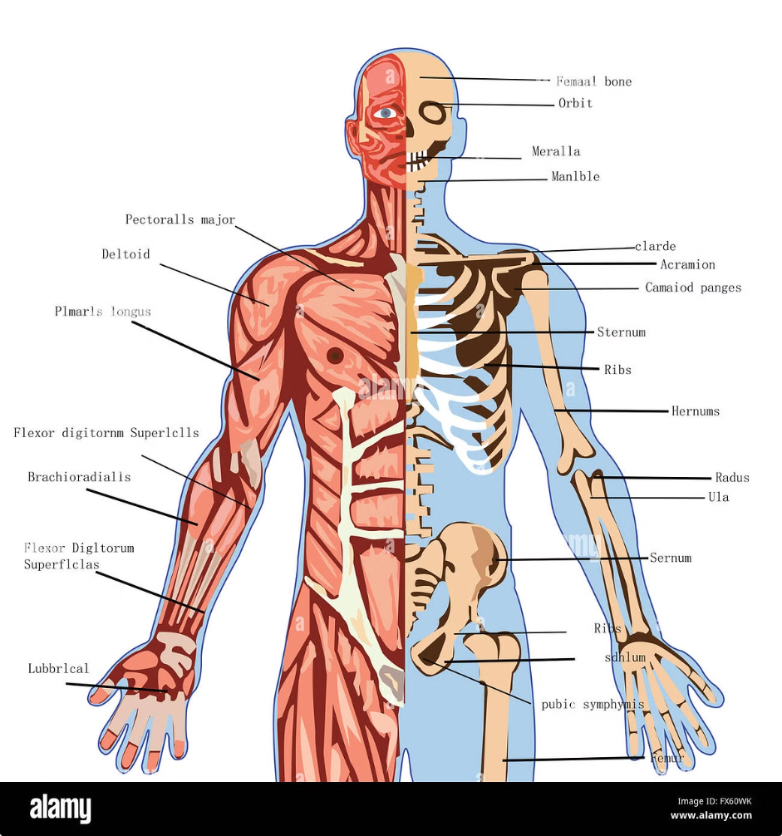
Introduction to Hurt and Grievous Hurt
1
Physical Injury
2
Legal Significance
Hurt and grievous hurt refer to any physical injury, ranging from minor cuts and bruises to life-threatening wounds.
These terms are crucial in legal proceedings, particularly in cases involving assault, battery, or negligence.
3
Criminal Law
Hurt and grievous hurt are often categorized as offenses in criminal law, carrying varying degrees of punishment.

Slide 3

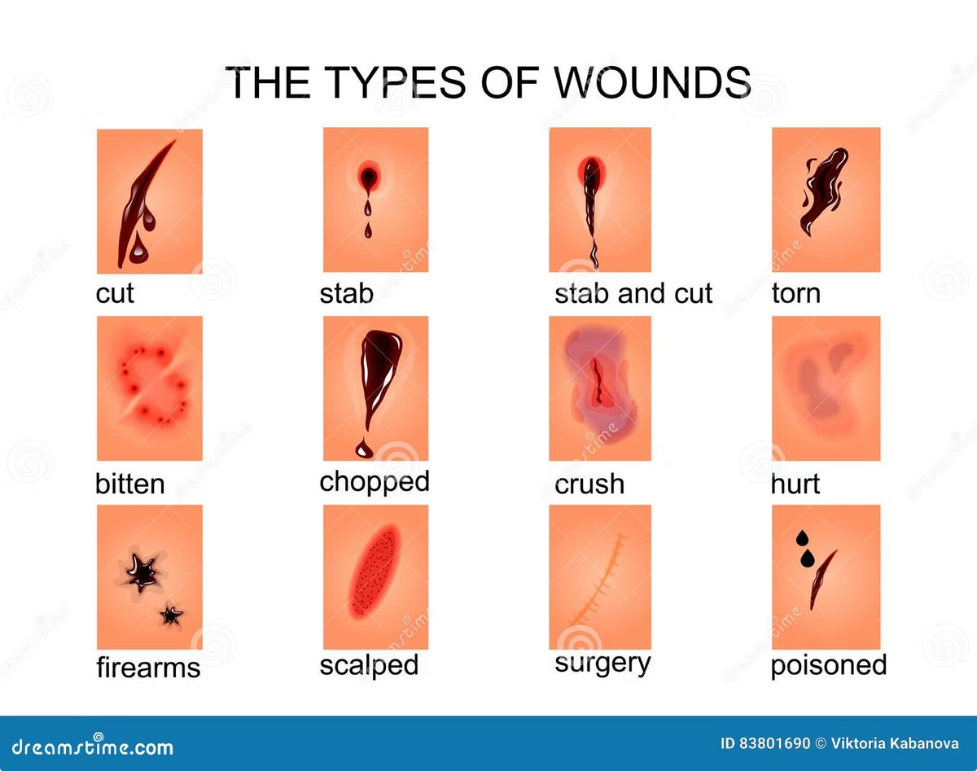
Types of Hurt
Simple Hurt
Minor injuries, causing temporary pain or discomfort, like bruises or cuts.
Grievous Hurt
Serious injuries, causing prolonged pain, disability, or disfigurement, like broken bones or permanent loss of function.

Slide 4
Defining Hurt and Grievous Hurt
Simple Hurt
Grievous Hurt
Minor injuries, causing temporary pain or discomfort, like bruises or cuts.
Serious injuries, causing prolonged pain, disability, or disfigurement, like broken bones or permanent loss of function.

Slide 5


Legal Perspective on Hurt and Grievous Hurt
Criminal Law
1
Hurt and grievous hurt are offenses under various criminal codes, leading to imprisonment or fines.
2
Civil Law
Victims can file civil lawsuits seeking compensation for damages related to injuries.
Evidence
3
Medical reports, eyewitness accounts, and other evidence are crucial in proving the extent of injury.

Slide 6





Assessing the Degree of Hurt and Grievous Hurt
Severity
The degree of injury is assessed based on the nature, extent, and duration of pain and suffering.
Impact on Function
The extent to which the injury affects a person's ability to perform daily activities.
Permanent Disability
Whether the injury results in lasting physical impairments or limitations.

Slide 7

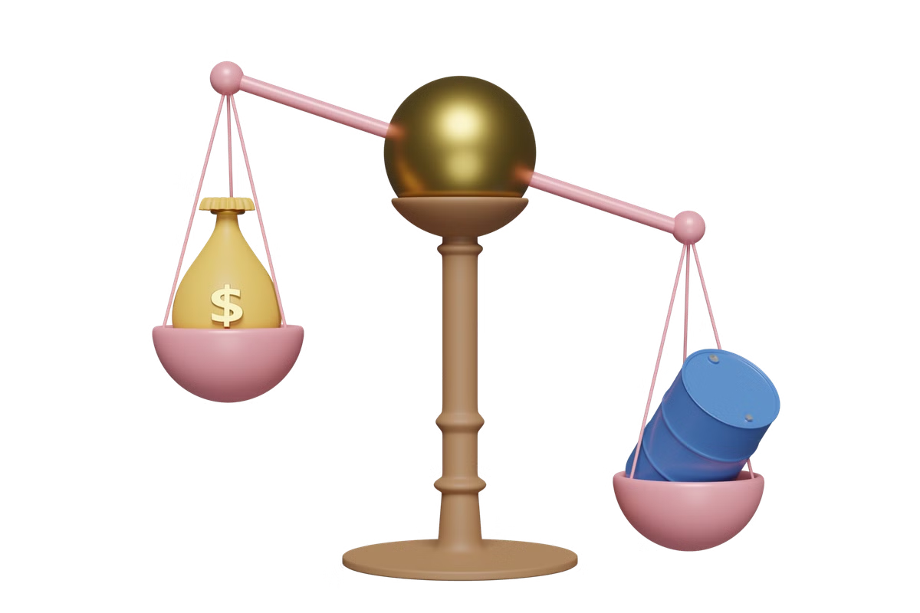
Compensation and Liability for Hurt and Grievous Hurt
Damages
Liability
Victims can receive compensation for medical expenses, lost wages, pain and suffering, and permanent disability.
Determining who is responsible for the injury is crucial. It could be the perpetrator, a negligent party, or an employer.
Insurance
Insurance policies often cover medical expenses and other liabilities related to injury.

Slide 8





Conclusion and Key Takeaways
Understanding the Law
Knowledge of the legal definitions and consequences of hurt and grievous hurt is crucial for both individuals and legal professionals.
Seeking Legal Advice
If you or someone you know has suffered an injury, it's crucial to seek legal advice to protect your rights.
Medical Documentation
Maintaining thorough medical records and documentation is vital in supporting injury claims and legal proceedings.

Slide 9


